Slide 1
Beyond Teachers: Careers in Education
Paolo Varquez, M.S.
Career Specialist / PT Instructor Technology Chair
Coastline College California Career Development Association

Slide 2
Background
Technology Chair / Keynote Speaker - California Career Development Association
Career Specialist - Coastline College
Adjunct Counselor / Instructor - Counseling 104: Career and Life Planning
Presented “Best Practices: Career Exploration” - OC CTE Network
Career Exploration - Guided Pathways Committee
21st Century World of Work - Employability Skills
Certified in MBTI and Strong Interest Inventory
Interests / passions: Career development, counseling, education, and exploration
Thesis: Career development activities of school counselors in predominantly Latino high schools
Dissertation: Major and Career Decision Making for Latinx Transfer Students
Notes:
2 mins

Slide 3
Why do you want to work in education?

Slide 4
Agenda
Career success formula
Exploring careers in education
Educational institutions structures
Understanding different classification
Education job Search Engines

Slide 5
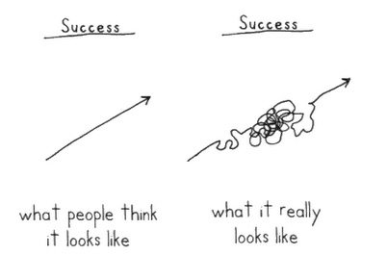
Career Success Formula
+Self-Exploration
+Degrees / Credentials / Certificates / Licenses
+Marketing
+Relevant Experiences
xActive Networking
+Luck
Created by: Paolo Varquez
Career Theories: Theory of Choice Choice (Holland), Social Cognitive Career Theory (Lent, Brown, Hacket), Trait and Factor Theory of Occupational Choice (Parson) Happenstance Learning Theory (Krumboltz), Lifespan Theory (Super)
Notes:
Krumboltz’s theory Happenstance Learning Theory

Slide 6
Reflection

Slide 7
Exploring Educational Institutions Differences
P-12
Preschool
Elementary
Junior High
High School
Adult / Continuation schools
Higher Education
Community College
California State University (CSU)
University of California (UC)
Technical Colleges
Types
Public
Private (e.g. religious, military)
Charter
Magnet
Home
Online
Sources: understood.org, babycenter.com

Slide 8
Education Job Search Engines
K-12: https://www.edjoin.org/
Higher Education: https://www.higheredjobs.com/
Take 10 minutes exploring and writing interesting jobs you found. Be ready to share :)

Slide 9
Exploring Job Classifications Differences
Hourly
Temporary
Classified
Specialist, Assistants, Technicians
Faculty / Certified
Teachers / Instructors / Professors / Counselors
Administrators
Assistant Principal/ Principles
Directors / Deans
Executive Administrators
Chancellors / Vice Chancellors
Superintendents
President / Vice Presidents

Slide 10
Career Exploration
CaCareerZone.org
BLS.gov
Google “Careers in Education”
Take 10 minutes to explore careers in education, write interesting jobs you found, and be ready to share :)

Slide 11
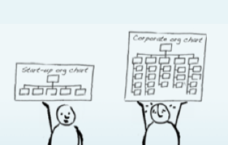
Exploring Educational Institutional Structures
Every structure is different
There are so many positions
There’s always someone higher
Coastline College
Walnut High School
Ocean Grove Charter School

Slide 12
Exploring College Programs - Beyond Education
Bachelors: Assist.org
Masters and PhD: Gradassist.org
Take 10 minutes to explore college programs, write interesting programs you found, and be ready to share :)

Slide 13
Next steps
Continue your search through the different sites
Browse through educational job search engines
Gain experience in area of interest ASAP
Share with your friends
Ask if you need help

Slide 14
What are some new careers you learned today?

Slide 15
Paolo Varquez, M.S.
Paolovarquez@gmail.com
linkedin.com/in/paolovarquez

Slide 16
Extras

Slide 17
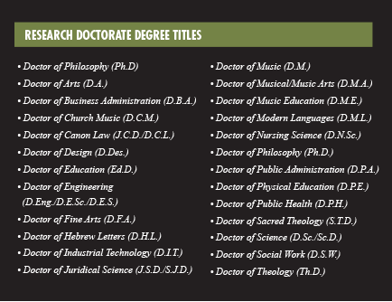

Slide 18
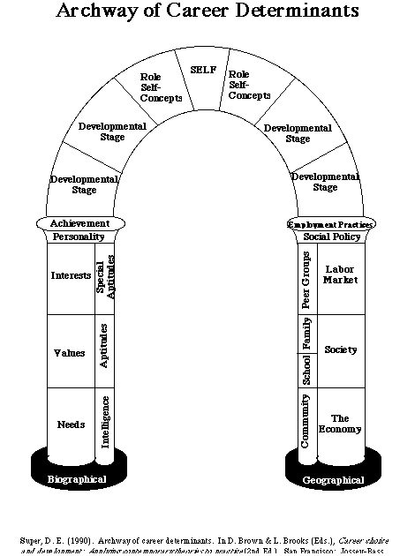
Experience / Exposure
Asking for experiene

Slide 19
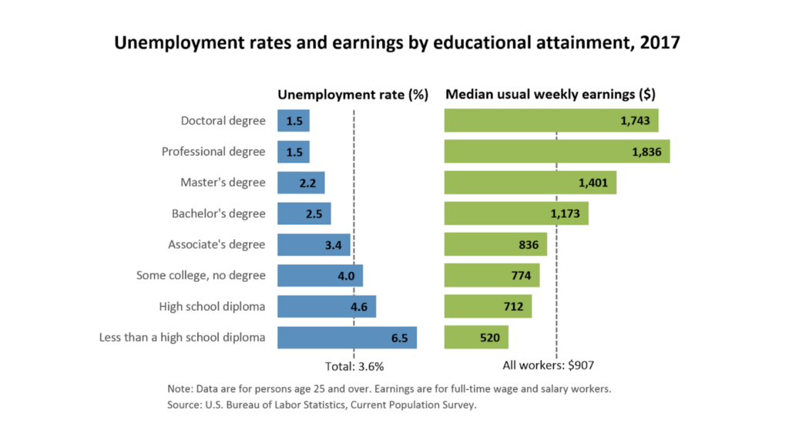
Exploring Undergraduate / Graduate Programs
Assist.org
Gradassist.org

